Slide 1
Pharmacy management System
Name : Osama Hisham Mohamed Azab
ID: 20100948

Slide 2
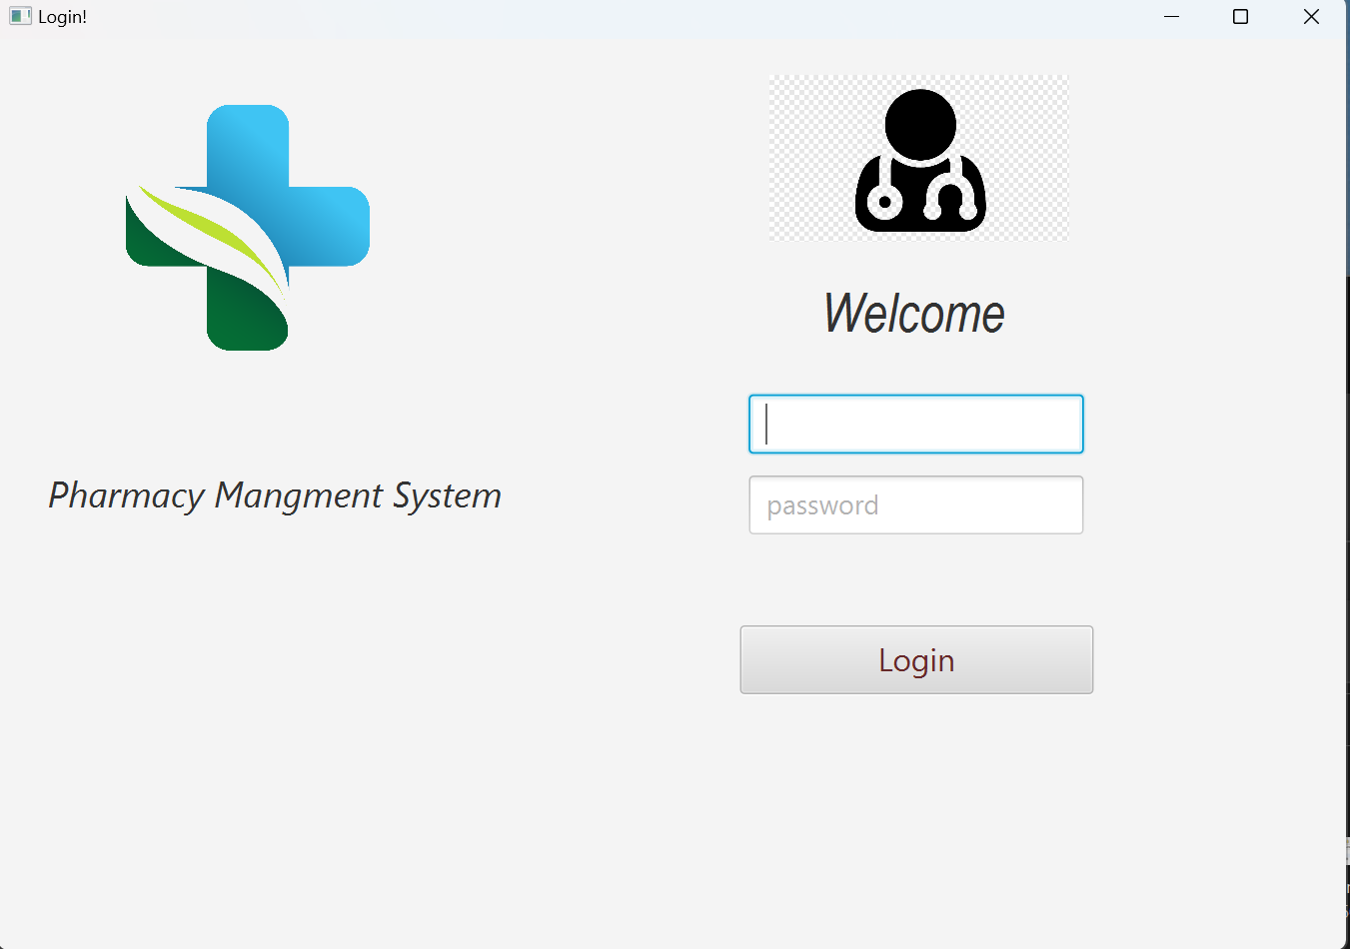
Login page

Slide 3
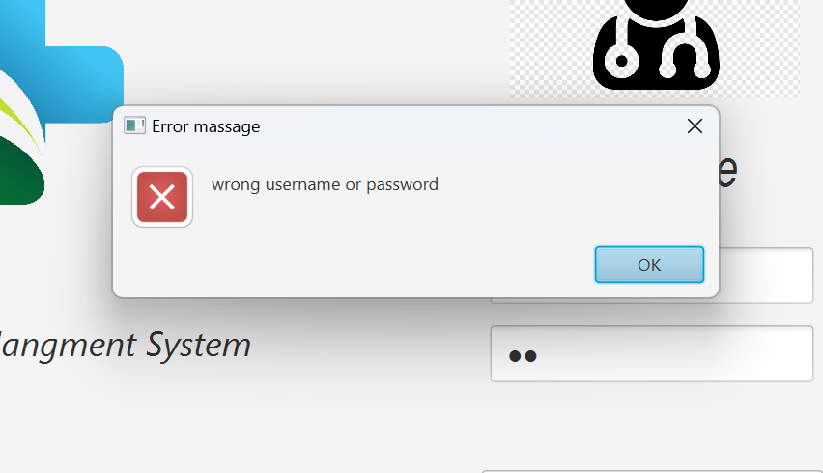
Error detecting the program cn detect if username and password are wrong

Slide 4
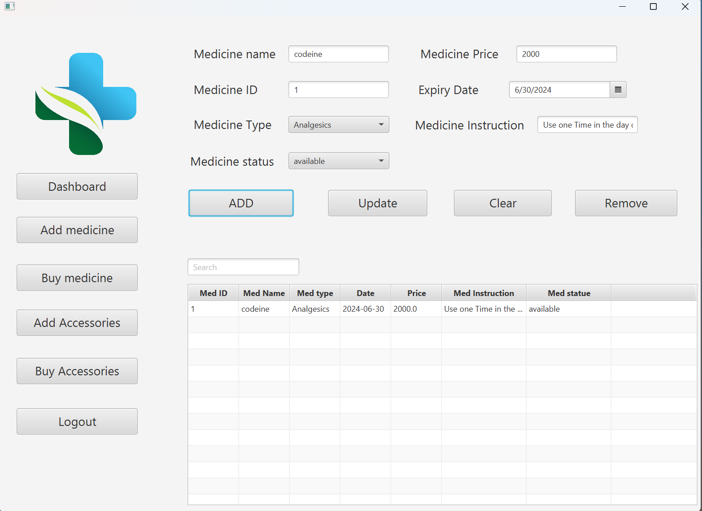
Adding medicine The program add data to database you can update or remove data from database

Slide 5
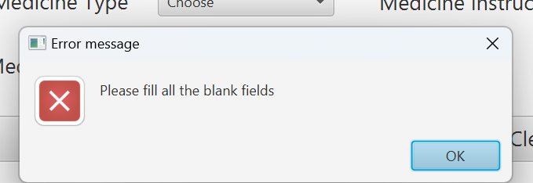
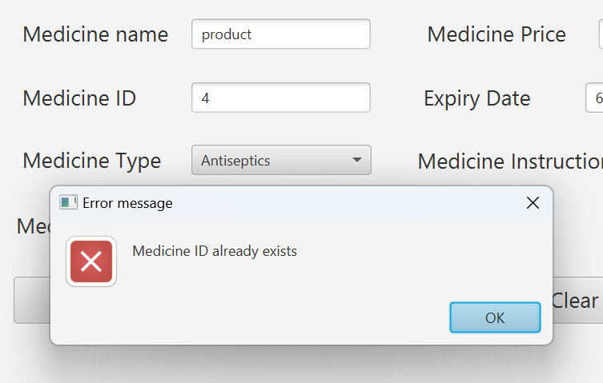
Detecting error

Slide 6
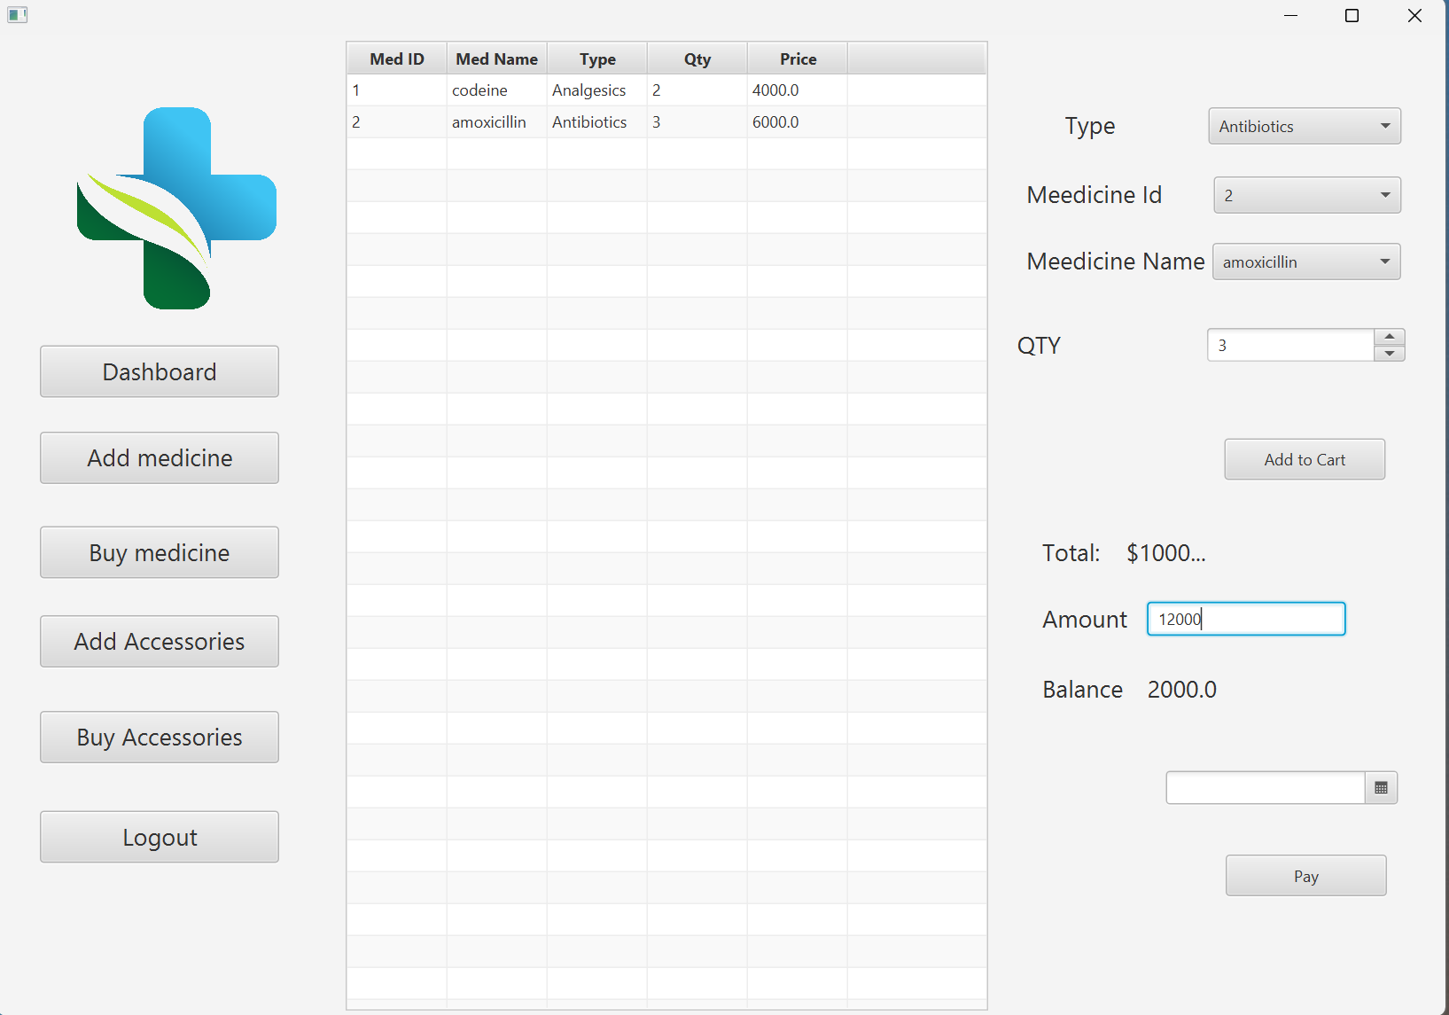
Buy medicine

Slide 7
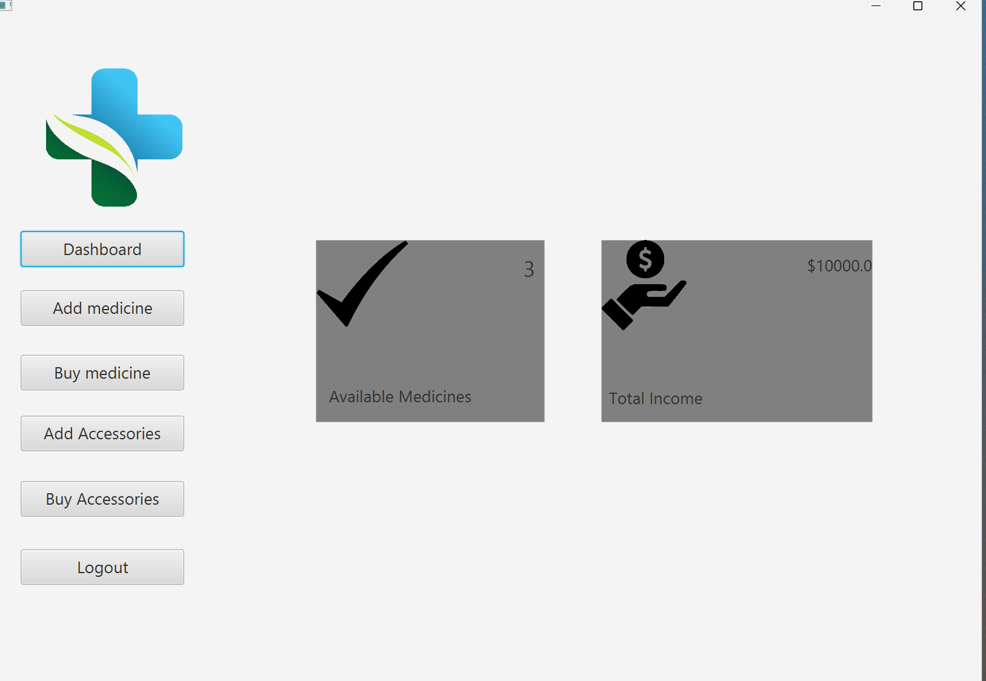
Dashboard

Slide 8



Database tables

Slide 9
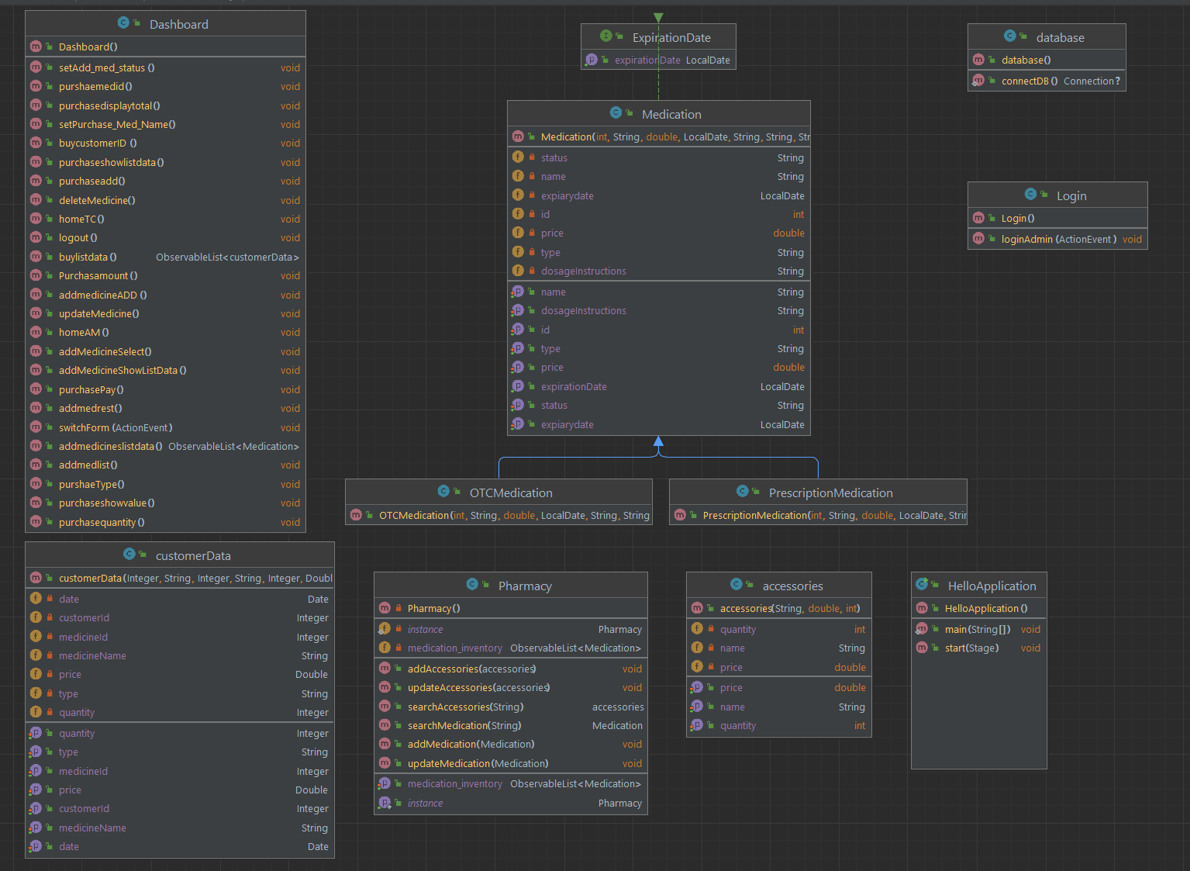
UML

